Slide 1
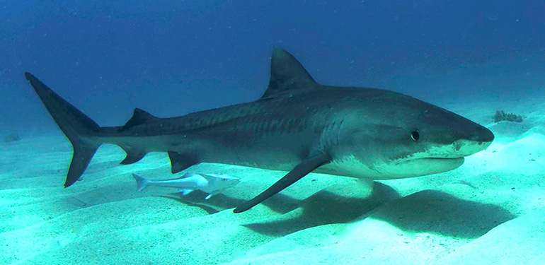
Sharklet
Image: Albert Kok/Creative Commons
Steps, Content & Hints
Main directions and content for the activity are in the boxes to the left with the orange border, like this one.
In a classroom setting, you will lead the students through the activity with a series of questions, the students’ own responses and brief explanations.
Whenever possible, find and affirm what’s right about the students’ answers.
Questions in Context:
Do you remember something better when you are asked to think about it?
On the right, in the conversation bubble outlined in yellow, are guiding questions that you should ask the students during the associated step.
Each question should be asked separately – and a short amount of time should be allowed for responses.

Slide 2
Green Chemistry Introduction:
Defining Green Chemistry
Have students work in pairs for 30 seconds to come up with a definition for green chemistry. Break down the meaning of both words.
Establish that Chemistry is the science of making products.
Eco-friendly, good for the environment, sustainable.
What is Chemistry? What does chemistry mean to you? Do you think of good things or bad things? Who has heard of companies going green? What does that mean?
Green chemistry is pollution prevention at the molecular level, the basic design stage. So what is it that chemists do?
What do chemists do?
Use wait time . Build off of their prior knowledge. Acknowledge student responses and prompt them for more information. Control the conversation by asking for a certain number of answers.
Chemists are inventors. They help to design just about every product out there.
Traditionally chemists were not taught about the environmental impact or toxicology. We have had many advances and helpful inventions but we have also had inventions that have caused harm to the environment. Green chemists design products taking into account the entire process, energy efficiency, renewable resources, the product itself along with the end-of-life impact of the product.
Is there anything in this room that a chemist invented? What about the desks, paint, floor, etc.
Who has taken medicine? Does anyone use an iPod or an mp3 player? What about a computer or a cell phone?
Would you buy a “traditional” cleaner that costs $1 or a “safer” cleaner that costs $5 for the same bottle size?
Would you buy a “traditional cleaner” that cleans well, or a “safer” cleaner that leaves streaks behind?
Green chemists think about safety, cost and performance in their product design
Set the Scene:
Connect the Dots & Introduce the Activity Topic
Connect the dots for them: they are the future scientists who will help to discover and invent solutions to our environmental challenges.
Introduce the 3 criteria of Green Chemistry:
Safety, Cost and Performance.

Slide 3
Have any of you ever heard the word “biomimicry” before? What about “bio”? What does it mean to “mimic”? Have you ever heard someone say “stop mimicking me!” – what do they mean when they say that?
So if “bio” means “life” and ”mimic” means “to copy”, then what might “biomimicry mean?
Introduce biomimicry:
Ask group if they have ever heard of biomimicry.
Break down into two parts
Bio = life
Mimicry = to copy
Put them together and what do you get? Copying life.
Biomimicry is taking inspiration from nature in the design of new technology.
For billions of years nature has been making really amazing materials and doing incredibly complex chemical reactions at normal pressure, normal temperature and without making any harmful waste. When we make materials and do reactions in the lab, often we use high temperature, high pressure and make all sorts of waste. Biomimicry can help us find new ideas for sustainable technologies in nature.
HELPFUL HINTS:
Depending on the attention span of the students (usually younger students have shorter attention spans!), you may want to take some of the pairs out of the deck and run a shorter game.
If you’re running this at an activity table, you may also want to go through the answers as the student matches them, rather than waiting till they have matched all the cards. This prevents lower level students from being overwhelmed and gives you a better gauge if you’re losing their attention.
Biomimicry matching game
To get us all thinking like a green chemist who looks to nature for ideas, we are going to play a game! Each group will receive a stack of cards containing pictures of technologies and pictures of things in nature. As a group, your goal is to match the things from nature with the technologies they inspire! When the groups are done, we’ll go through your pairs as a group. Be ready to explain why you made the pairs you did!

Slide 4
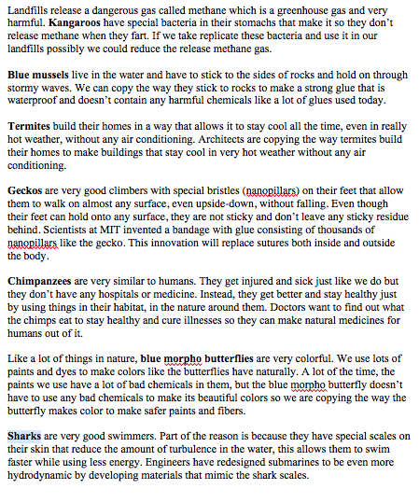
Debrief the matching game
There are two versions of the matching game. Be sure you’re looking at the answers or the game you’ve handed out!
Introductory Biomimicry Matching Game

Slide 5
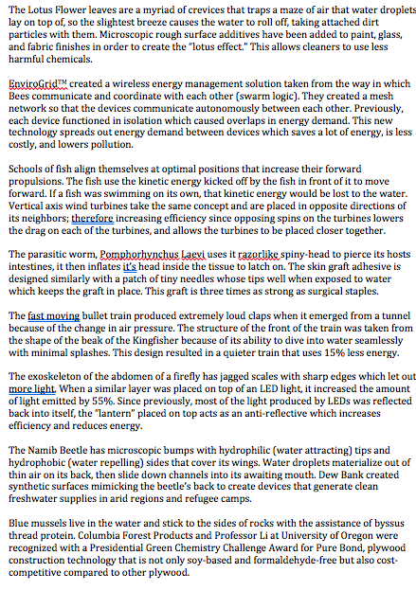
Debrief the matching game
There are two versions of the matching game. Be sure you’re looking at the answers or the game you’ve handed out!
Advanced Biomimicry Matching Game

Slide 6
Who can tell me what they know about sharks?
Students will probably talk about their teeth, how they can’t stop swimming, etc.
If you picture a whale, you probably picture barnacles and other things sticking to them. Do you picture that when you picture of shark?
Introduce Sharklet film
Ask the students what they know about sharks!
Ask the students if they ever noticed that nothing sticks to sharks.
Shark scales (denticles, if you want to be specific) make a really unique diamond pattern on the sharks that prevents things from sticking to the surface of the shark. Barnacles can’t stick, but neither can really small things like bacteria.
Scientists have developed an antimicrobial film inspired by this pattern on shark skin that prevents bacteria from growing on surfaces.
What do you know about bacteria? Some bacteria are good, some are bad! When we use the word “germs”, we’re often talking about bacteria that can make us sick.
Can you see the any type of pattern when you look at the film? What about when you hold it up to the light?
Show students the Sharklet film
Ask them if they can see any pattern just by looking at the film.
Use laser pointer to show diffraction pattern – hold the film planar with the table underneath it and shine the laser directly perpendicular to the surface of the film so that the pattern appears on the table below the surface.
Why can you only see the pattern when the laser is shined through the surface? Because the pattern is so small!

Slide 7
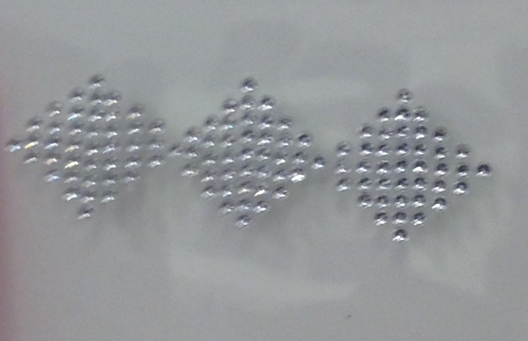

How does it work?
Show students the model of the Sharklet pattern. Encourage them to touch it if they want to.
How does the pattern feel when you touch it?
Image 1:
HELPFUL HINTS
Break the class up into small groups if you have multiple Sharklet models.
If you only have one model, do this activity with a few volunteers at the front of your classroom/activity space.
Let’s compare the “stickability” of the Sharklet pattern surface to a flat surface with a simulation.
  Place the sticky part of a post-it directly over the Sharklet pattern
  Place another post-it directly on the plastic sheet right next to the Sharklet pattern as seen in image 2.
  Have the participant(s) predict how many binder clips they’ll be able to hang on the post-its before they fall off
  Have the participant (or you, if they’re little or hands-off) add binder clips, one at a time, to the post-it on the Sharklet pattern until it falls. Count, then repeat on the non-Sharklet post-it
    Hint: Have them make guesses and add binder clips until their guess is met. Pause and give them the chance to guess again or (if time is running short) tell them the “answer”, which is anywhere from 30-60 binder clips
Image 2:

Slide 8
Why is it hard for the binder clips to stick to the Sharklet pattern?
Ask them to recall how the pattern felt when they touched it – it’s bumpy.
There is not enough surface area for the sticky note to adhere to. On shark denticles and on the Sharklet film, there is not enough surface area for the bacteria to grab hold of and grow on.
Why do you think it’s hard for the sticky note to stick to the Sharklet pattern?
Why is Sharklet film important? Where might we want to use it? Think hospitals, cell phones, school desks, etc.
Why is Sharklet important?
Ask students why they think Sharklet film might be important. If the students are high level enough, you can talk about bacterial resistance and how antibiotics and chemical cleaners can encourage bacterial resistance. Most students will have heard that “Lysol kills 99.9% of bacteria.” But what happens to the other 0.1% of bacteria?
By using Sharklet film, we’re not encouraging bacterial resistance. We’re not trying to kill the bacteria, so we’re not encouraging only the strongest to survive. Instead, we’re just telling the bacteria that they can’t grow here! That keeps us from getting sick and keeps the bacteria from getting stronger.
Any questions?
Wrapping up is always a good time to talk a little more about why you are in the classroom, what you are studying, researching or pursuing as a career.
In closing:
Green chemistry provides the tools needed for creating solutions to environmental challenges.
As a green chemist you can be a part of the solution by inventing better technologies for the future. Also remember that you do not need to be a scientist to make a difference in this world. As an informed citizen you have the power to influence change with your decision making, voting power and purchasing choices.

